Slide 1

All about
-R1

Slide 2
Types of LLMs
Source: Building a fully local "deep researcher" with DeepSeek-R1
https://www.youtube.com/watch?v=sGUjmyfof4Q&t=155s
 | Chat Models | Reasoning Models Synonymous to test-time scaling
Scaling Paradigm | Next-Token Prediction | CoTs, RL on CoTs
Reasoning Type | System 1 Inference is fast | System 2 Inference is slow
Interaction | Tokens are helpful | So called Thinking tokens can be overwhelming or even hidden in some cases.
Famous Models | GPT4, Claude, Llama, Granite, DeepSeek-V3 | OpenAI o1-o3 DeepSeek-R1
OpenAI-o1 was the first successful demonstration of a working reasoning model, but almost everything about it was kept proprietary.

Slide 3
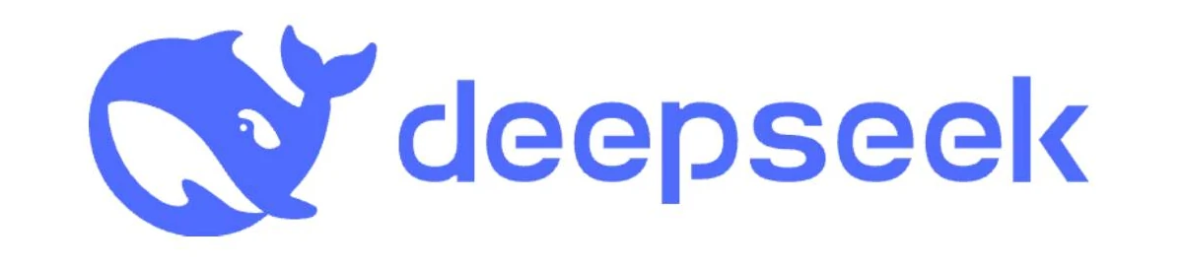
Why so much Hype?
A Technical Perspective
Open sourced the full pipeline for building Reasoning models
Open sourced the reasoning models of various sizes, some can even run on laptop
Algorithmic advances (a series of very innovative papers)
Low hardware usage
Low cost
Efficient inference
They did not open source the data
Did not talk about the money spent on iterations before the final run

Slide 4
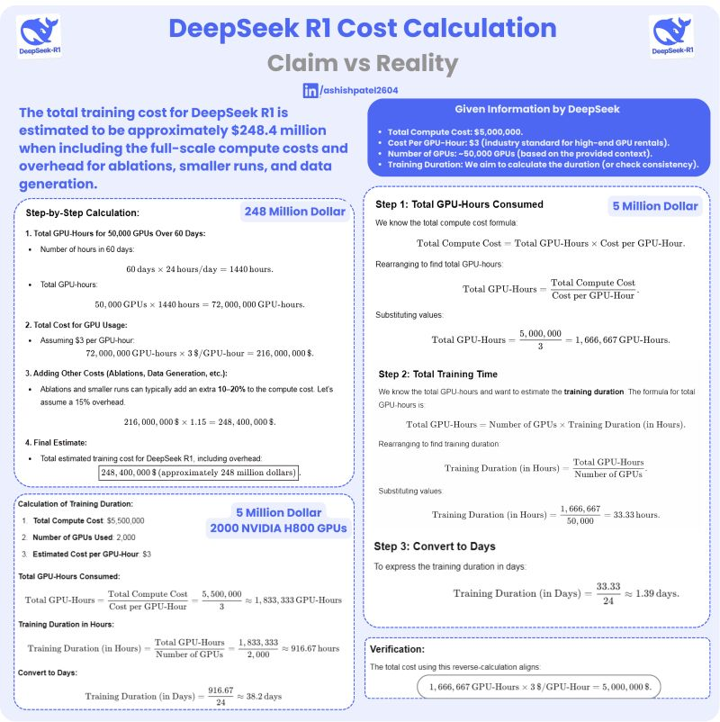
Real or Fake
As the models from DeepSeek are open-source, no one doubts the amazing progress by DeepSeek.
The two things being discussed are:
Cost
$6 million is the cost of the final training run
What is the actual cost?
Data
Distilling from OpenAI: cannot be very useful as OpenAI o models does not provide reasoning traces
Other models can be used for QA pairs, potentially with simple CoT
https://www.linkedin.com/posts/ashishpatel2604_artificialintelligence-machinelearning-datascience-activity-7289891875572875265-80Tr/

Slide 5
Ok, now tell me what is
so special about
?
-R1

Slide 6
First, we will have to
understand
-V2/V3
https://github.com/deepseek-ai/DeepSeek-V2/blob/main/deepseek-v2-tech-report.pdf
https://github.com/deepseek-ai/DeepSeek-V3/blob/main/DeepSeek_V3.pdf

Slide 7
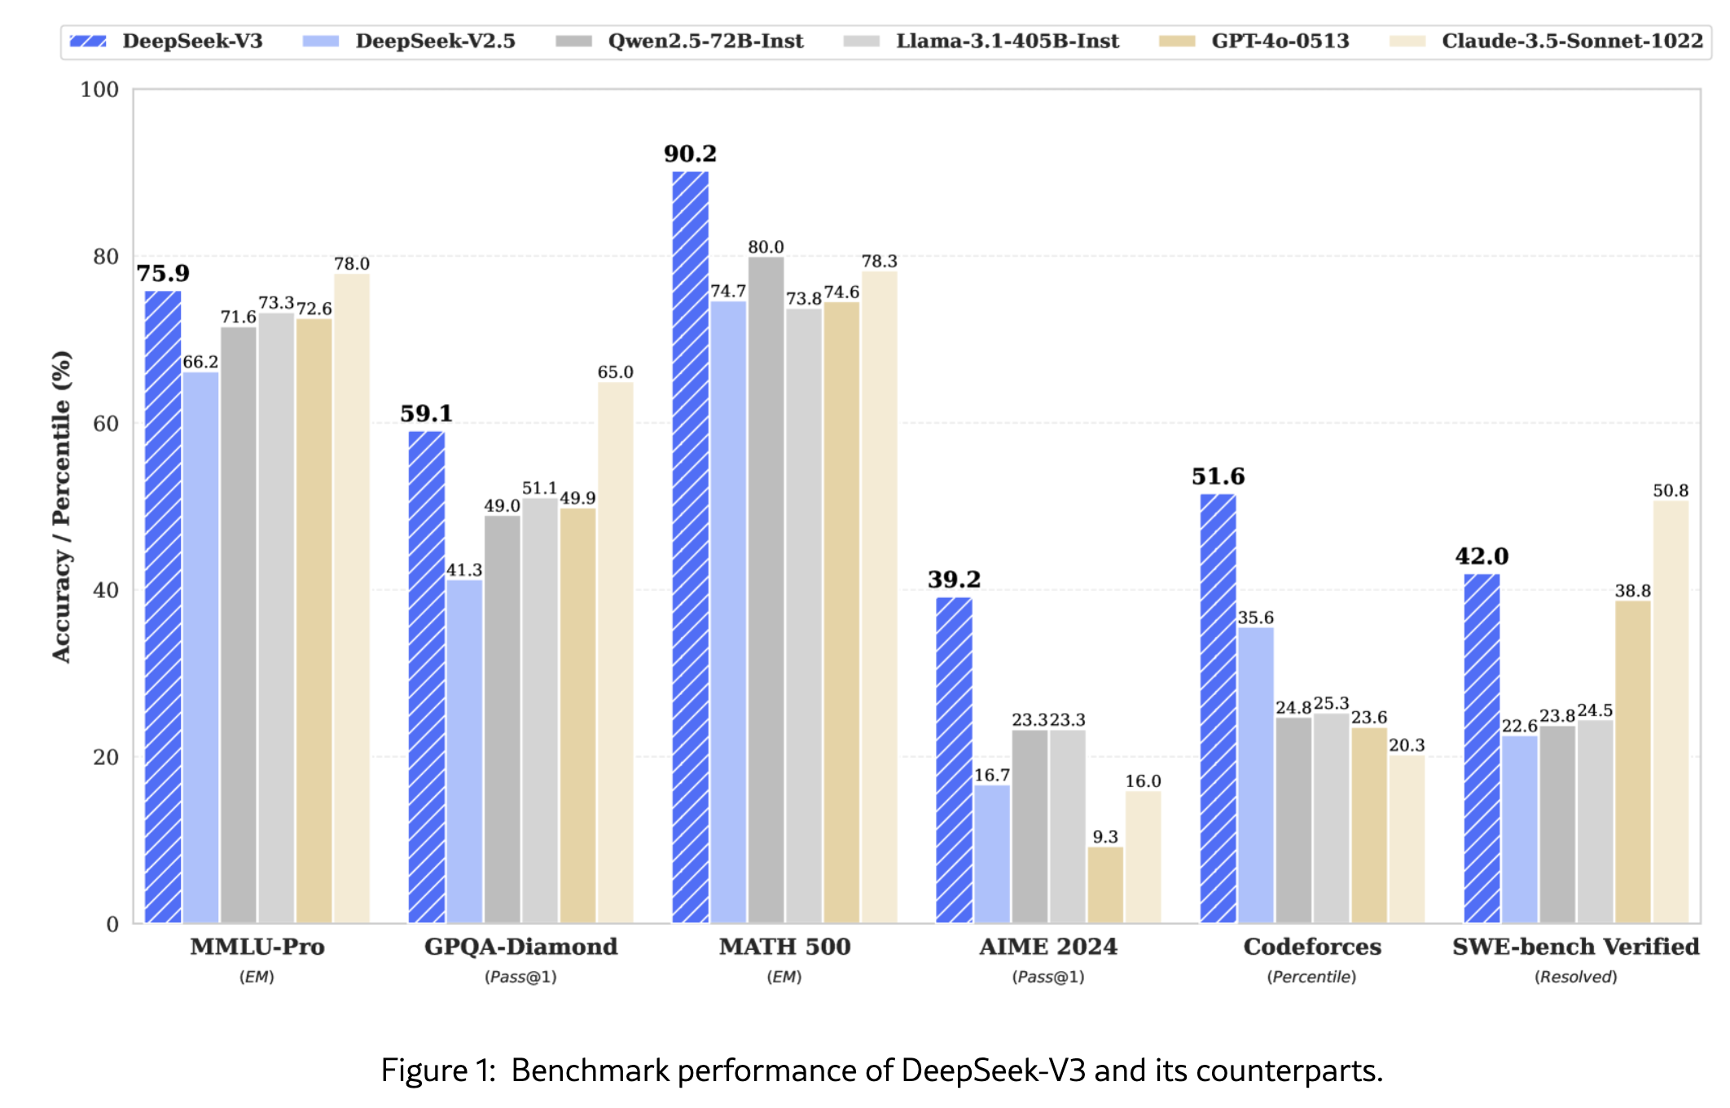
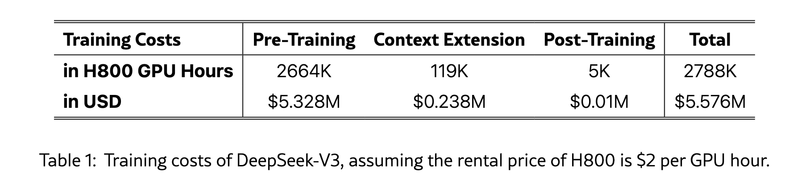
DeepSeek-V2,V3 Chat models
V3 was released in December 2024
671B (37B activated for each token)
Base models for R1
Some of the innovations in V2-V3:
DeepSeekMoE with Auxiliary-Loss-Free Load Balancing
Multihead Latent Attention (MLA)
Group Relative Policy Optimization (GRPO)
Multi-token Prediction
Post-training with 1.5 million R1 reasoning examples
FP8 mixed precision training framework
Communications and compute interleaving

Slide 8
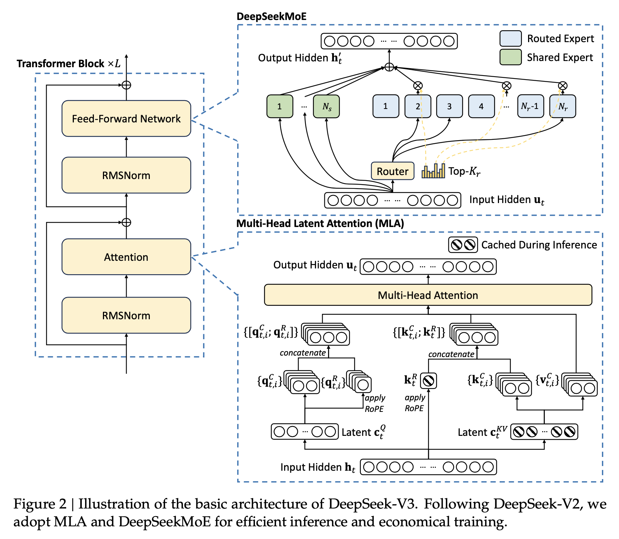
DeepSeekMoE
DeepSeekMoE is a type of Mixture-of-Experts (MoE) architecture. It uses a combination of shared and routed experts to process different parts of the input sequence.
The shared experts are used for all tokens, while the routed experts are selected based on the input token’s characteristics.
Auxiliary-Loss-Free Load Balancing
DeepSeek-V3 introduces an auxiliary-loss-free load balancing strategy, which helps to distribute the workload evenly across the experts.
This is done by using a routing mechanism that selects the experts based on the input token’s characteristics, without adding any additional loss terms to the model.

Slide 9
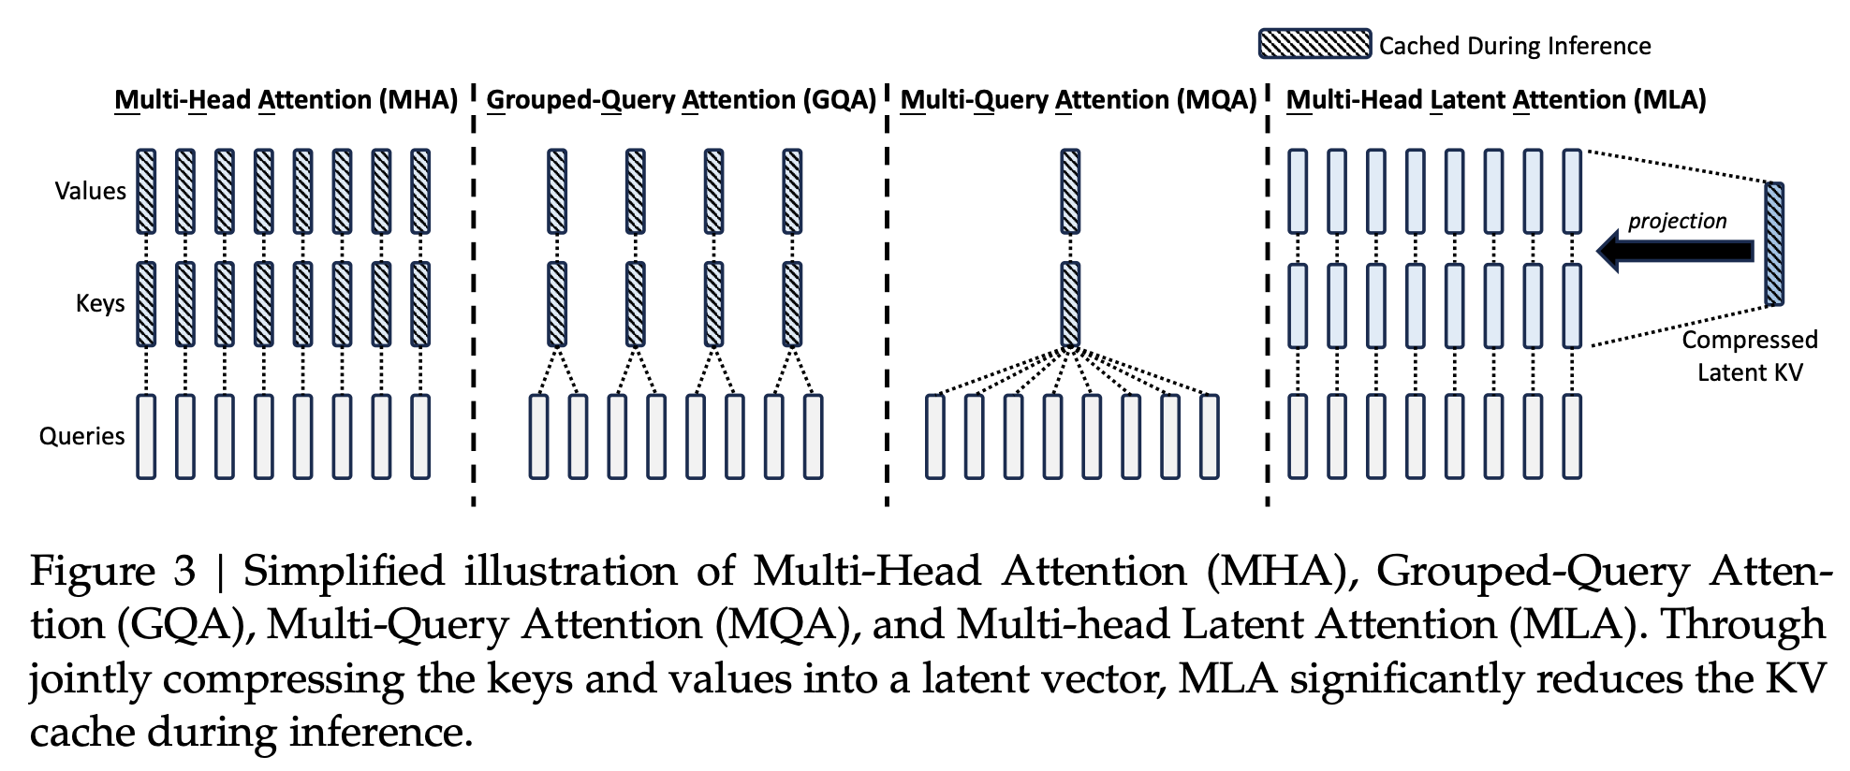
Multi-Head Latent Attention (MLA)
In a way, it is doing similar compression to what LORA did for model weights.
It reduces the memory requirements during inference by using a low-rank joint compression for attention keys and values.
This allows the model to efficiently process long sequences of text.

Slide 10
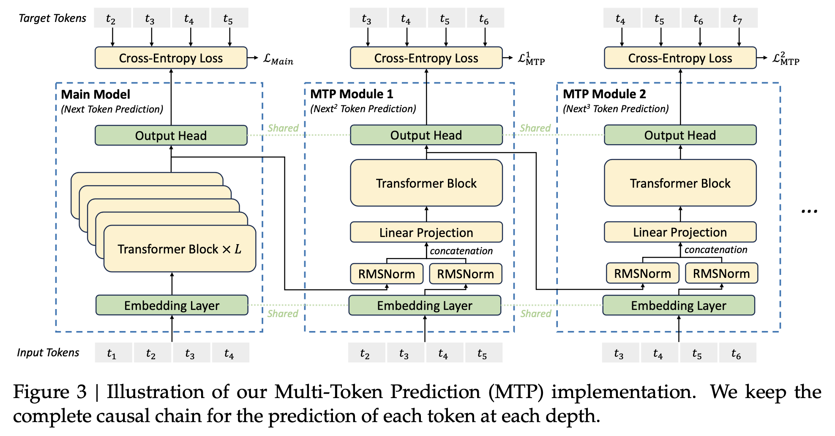
Multi-Token Prediction
Predict multiple tokens in a sequence simultaneously.
Helps the model to learn longer-range dependencies and improve its overall performance.

Slide 11
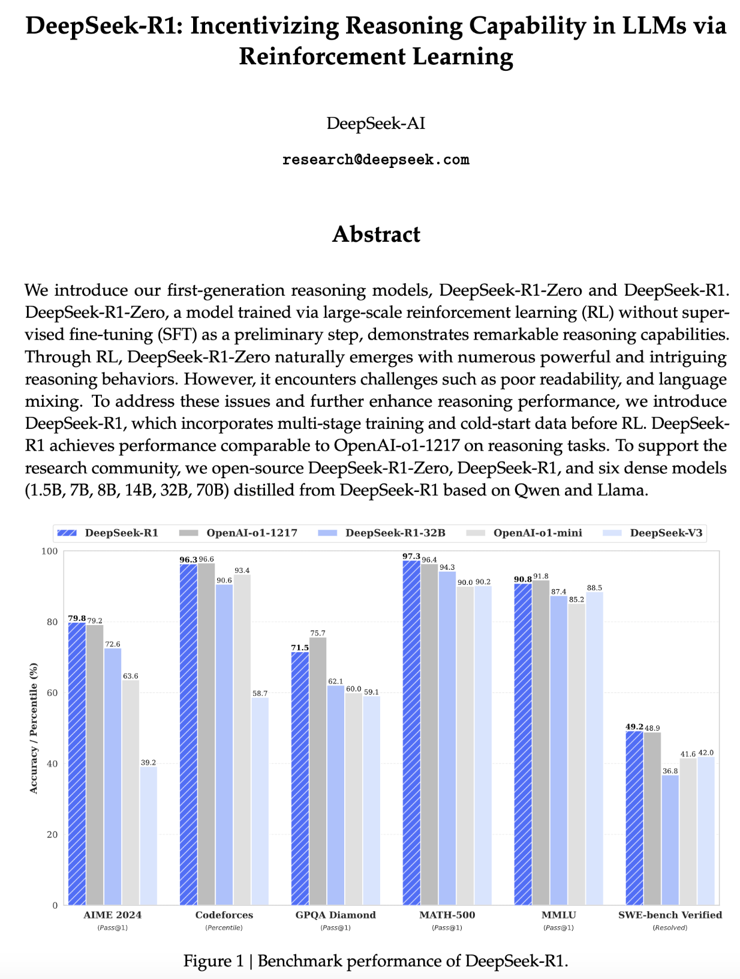
- R1
https://github.com/deepseek-ai/DeepSeek-R1/blob/main/DeepSeek_R1.pdf
Slides in this section are Inspired by:
Building a fully local "deep researcher" with DeepSeek-R1
https://www.youtube.com/watch?v=sGUjmyfof4Q&t=155s

Slide 12
DeepSeek-V3
Qwen 1.5, 7, 14, 32b
Llama 8, 70b
1000s of CoT examples with Human in the Loop Curation
Fine-tune
Good model to start RL
Reasoning: ~144k CoT GSM8K, MATH, etc
GRPO with 2 rule-based rewards
Fine-tune with Distillation
Filter
Stronger reasoning, weaker general capabilities
Distilled R1 Models
~200k non-reasoning examples (writing, QA)
Fine-tune
~600k quality reasoning traces
Stronger reasoning, restored general capabilities
Reasoning + General: Mix of data types
GRPO with rule-based and RM for non-reasoning
DeepSeek-R1
Reasoning while prioritizing helpfulness and harmlessness

Slide 13
Cold Start (Fine-Tune)
What
Fine-tuning of DeepSeek-V3-Base
Why
Give the model basic reasoning capabilities / patterns, stable RL foundation, output format
Data
Thousands of CoT examples with Human curation
They tried to train a model without Cold Start (only with RL). They call it DeepSeek-R1-Zero.
The model demonstrated capabilities such as self-verification, reflection, and generating long CoTs, marking a significant milestone for the research community.
However, DeepSeek-R1-Zero encounters' challenges such as endless repetition, poor readability, and language mixing.

Slide 14
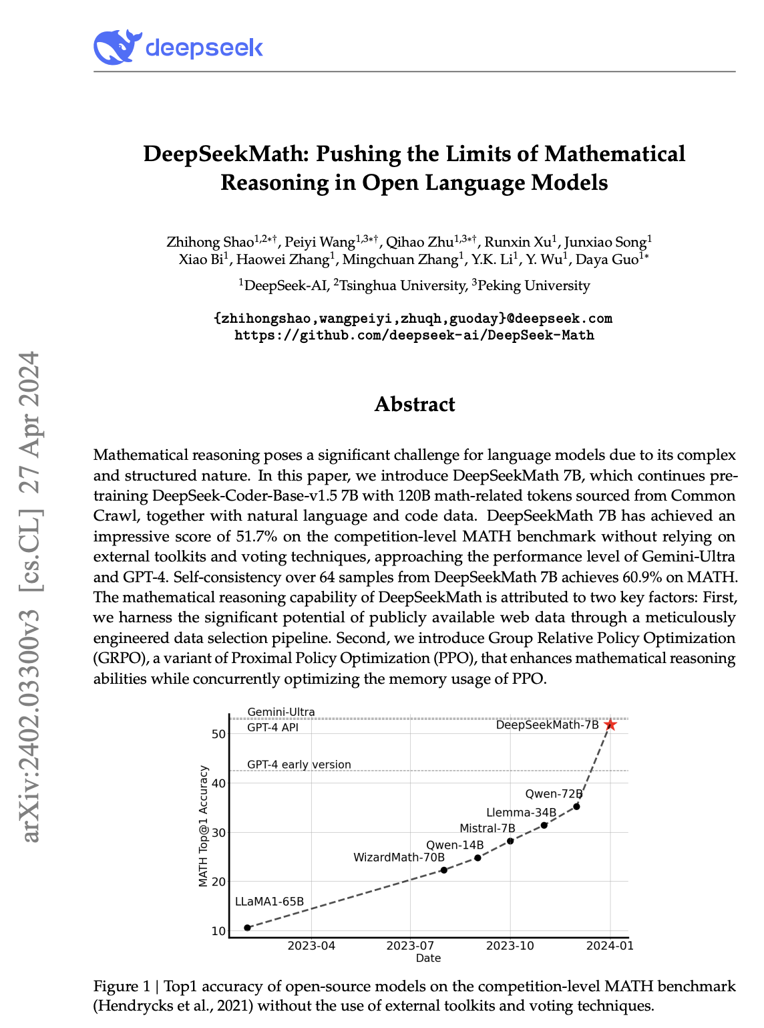
GRPO: Group Relative Policy Optimization
What
64 samples per training example
Score each one w/ a rule-based reward (e.g., correct/incorrect for math, coding)
Compare each sample to the mean of all samples
For samples with high (low) normalized reward above (below) the group mean:
Increase (drop) probability of the model generating all the tokens in that sequence.
Each token in the sequence get a positive (negative) gradient update.
Let’s make all the choices that led to it more (or less) likely in the future.
Why
"Discover" good reasoning patterns, makes the model very strong at reasoning
Lost some general capabilities
Had potential language mixing issues
Data
~144K CoT format GSM8K and MATH questions on reasoning-intensive tasks
https://arxiv.org/abs/2402.03300

Slide 15
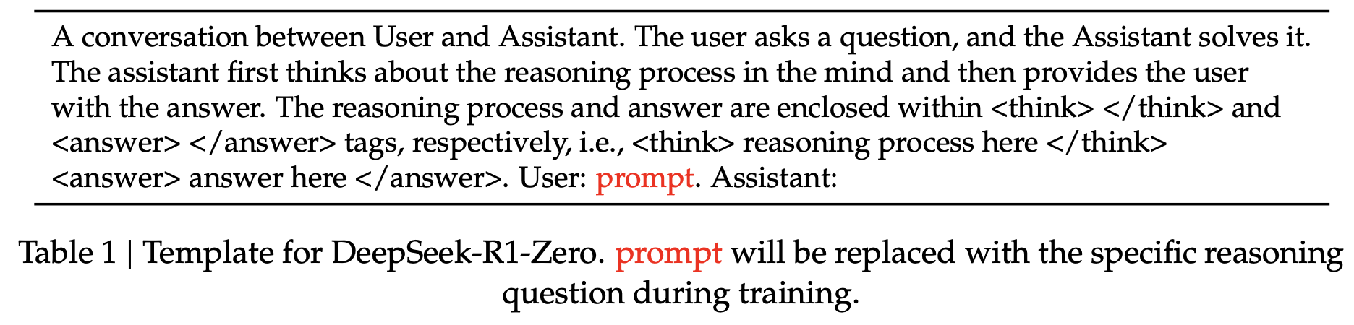
Rule-based Reward
Accuracy rewards
The accuracy reward model evaluates whether the response is correct.
Math problems → Check if results match (deterministic), and answer appear in specified format.
LeetCode problems → A compiler can be used to generate feedback based on predefined test cases.
Format rewards
Check if the response is formatted properly, e.g. put its thinking process between ‘<think>’ and ‘</think>’
tags.
Do not apply outcome or process neural reward, because we find that the neural reward model may suffer from reward hacking in the large-scale reinforcement learning process, and retraining the reward model needs additional training resources and it complicates the whole training pipeline.

Slide 16
Rejection Sampling
What: Generate new training data by filtering results from RL stage 1
Why: Results in 600k reasoning traces
Data: 600k + 200k non-reasoning (writing, factual QA, etc) DeepSeek-V3's SFT dataset
Fine-Tune
What: Fine-tuning of RL stage 1 model
Why: “Bake” reasoning patterns in, restore general capabilities
Data: Data from rejection sampling, ~800k samples
RL stage 2
What: GRPO reinforcement learning
Rule-based reward (from RL Stage 1) for reasoning
Reward models for helpfulness and harmlessness on general data
Why: Optimizing for both reasoning + general capabilities
Data: Mix of reasoning data and general data

Slide 17
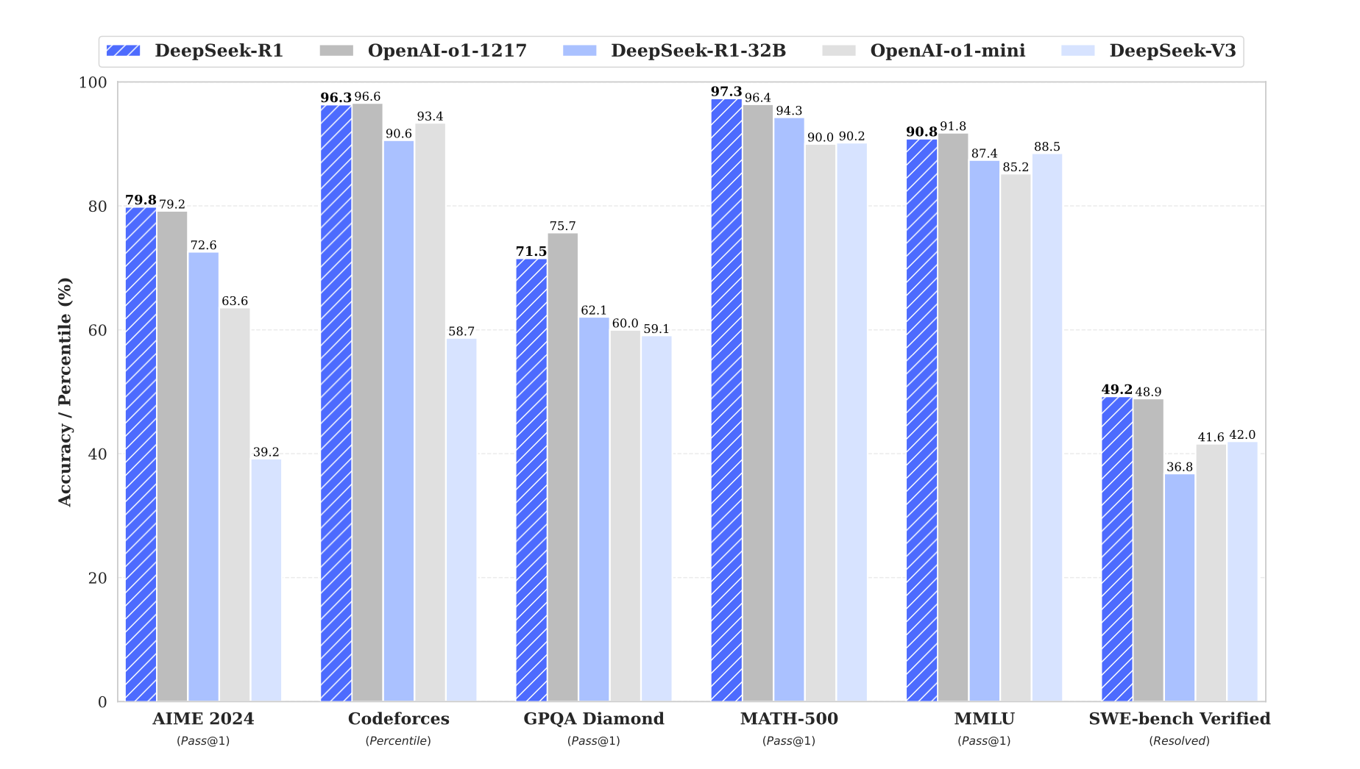
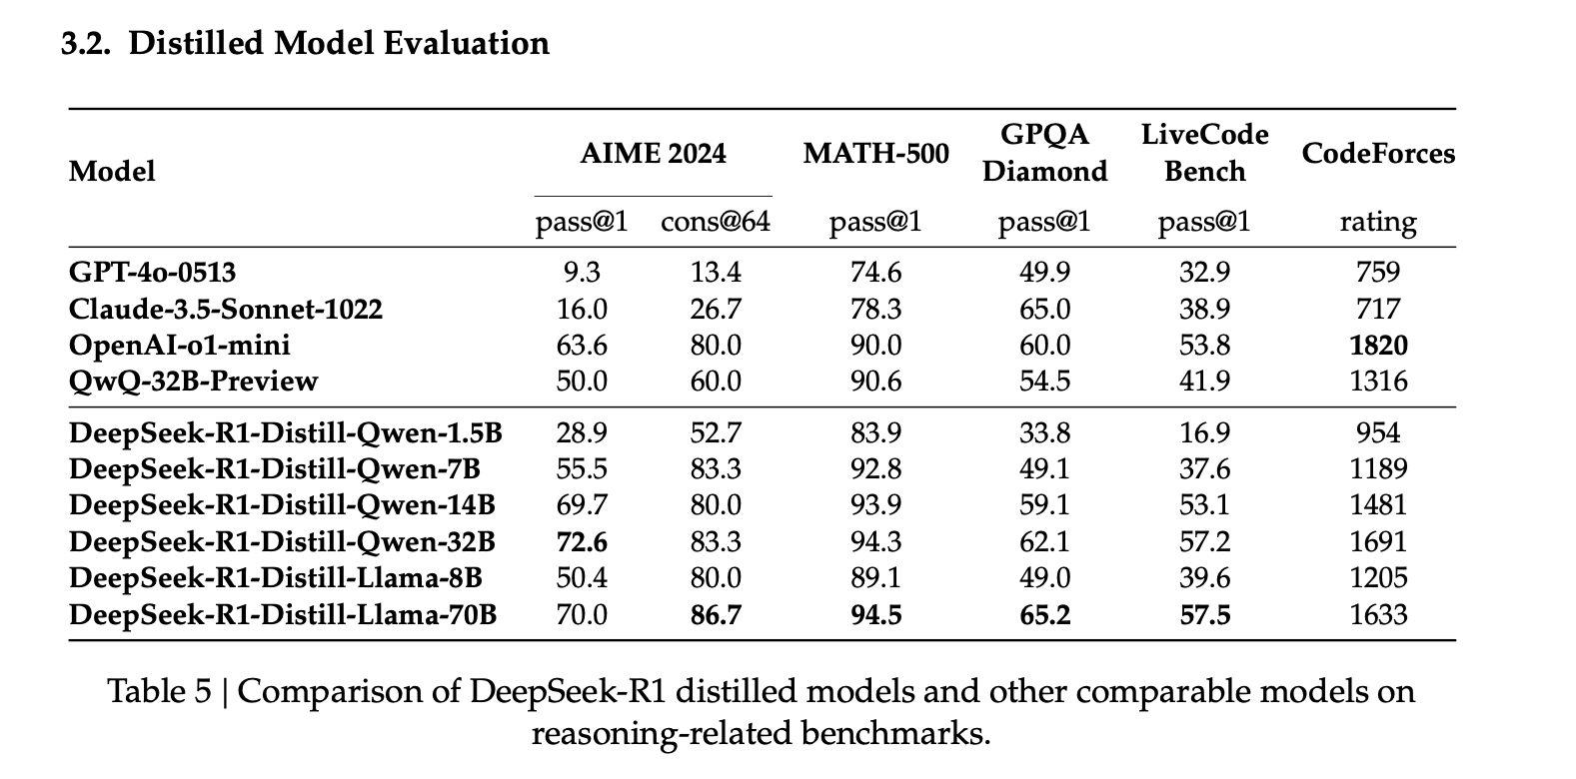

Slide 18
Should I be concerned when I use DeepSeek?
DeepSeek does keep your input prompts, just like all others do.
As DeepSeek models have been open-sourced, it is now available through all famous cloud-based services like:
IBM WatsonX
Microsoft Azure
NVIDIA NIM
….
In this case the data will stay on the servers of the service providers.

Slide 19
Conclusions
DeepSeek-R1 published a report on how to build a reasoning pipeline
Open-sourced R1 model
Distilling from a stronger teacher is much better than RL on smaller models
Algorithmic Innovations always win over brute force approach
Simple rewards can also be very helpful
Better RL
Improving reasoning might reduce generalization for the model
Cold start and fine-tuning again helps restore generalization

Slide 20





youtube.com/@asimmunawar
x.com/asimunawar
linkedin.com/in/asimmunawar
https://github.com/asimmunawar/ml-course
Asim Munawar

